Slide 1
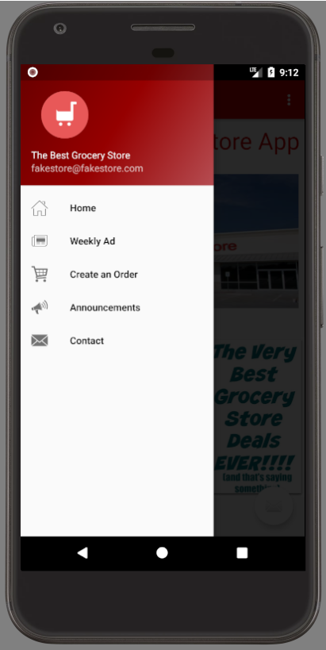
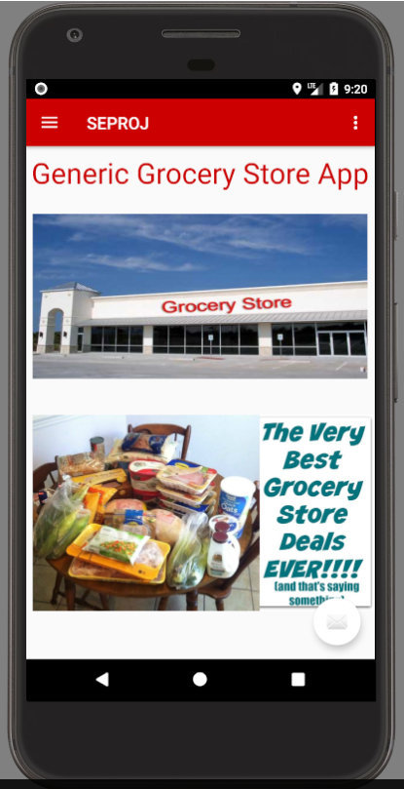
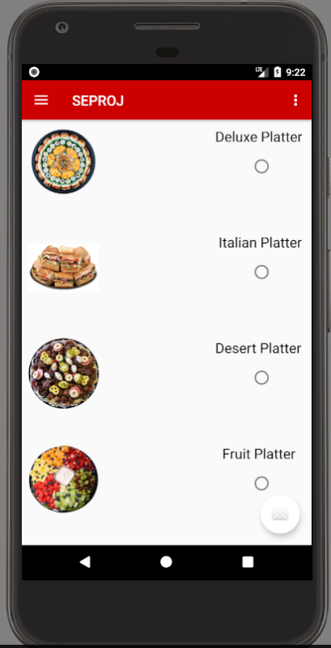
SE Project: Grocery Store App
Tim Joyce, Michael Sousa, Nicholas Wisniowski

Slide 2
Project Plan
Week 1
First Meeting: requirements developed, rolls assigned
Tim: Get SDK working, Provide initial template, announcements page, SQA
Mike: Diagrams for initial design, Weekly Ad, Contacts, Home page, SQA
Nick: Product Requirements, Design Document, Test Cases, Menu page, SQA
GitHub created, design documents made, prototype app worked on, test cases developed
Week 2:
Second Meeting: checked progress, revised project documents, implemented more features in app, prepared for this presentation

Slide 3
Requirements
Functional
Home Page
NavBar
Home Page
Menu Items
Ordering System
Weekly Ad
Announcements
Contact
Non-Functional
Easy to use

Slide 4
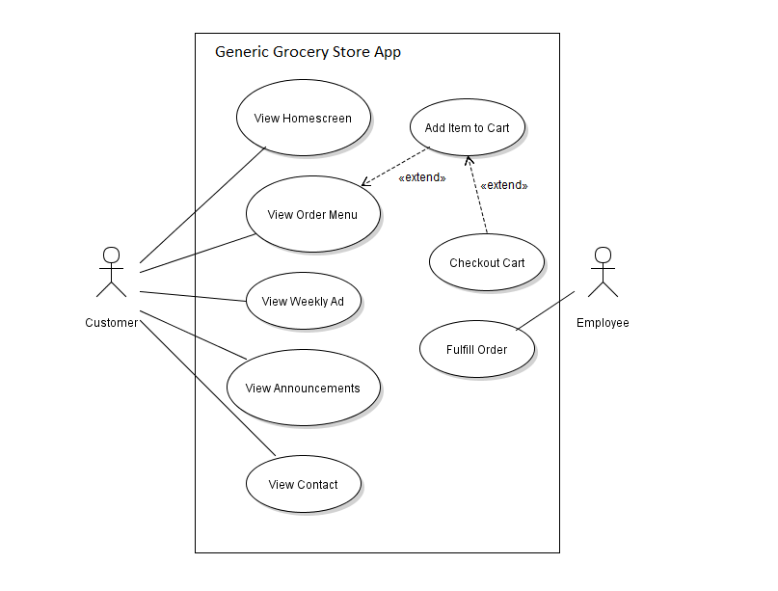
Software Design Documents:
Use Case Diagram

Slide 5
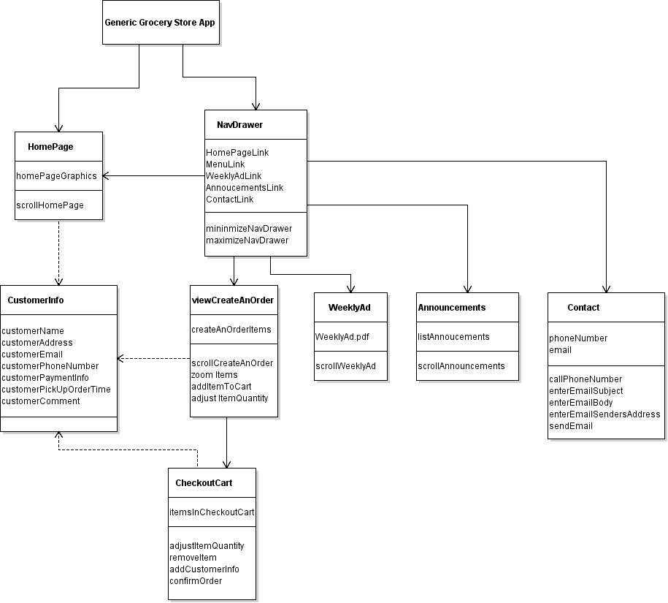
UML Diagram

Slide 6
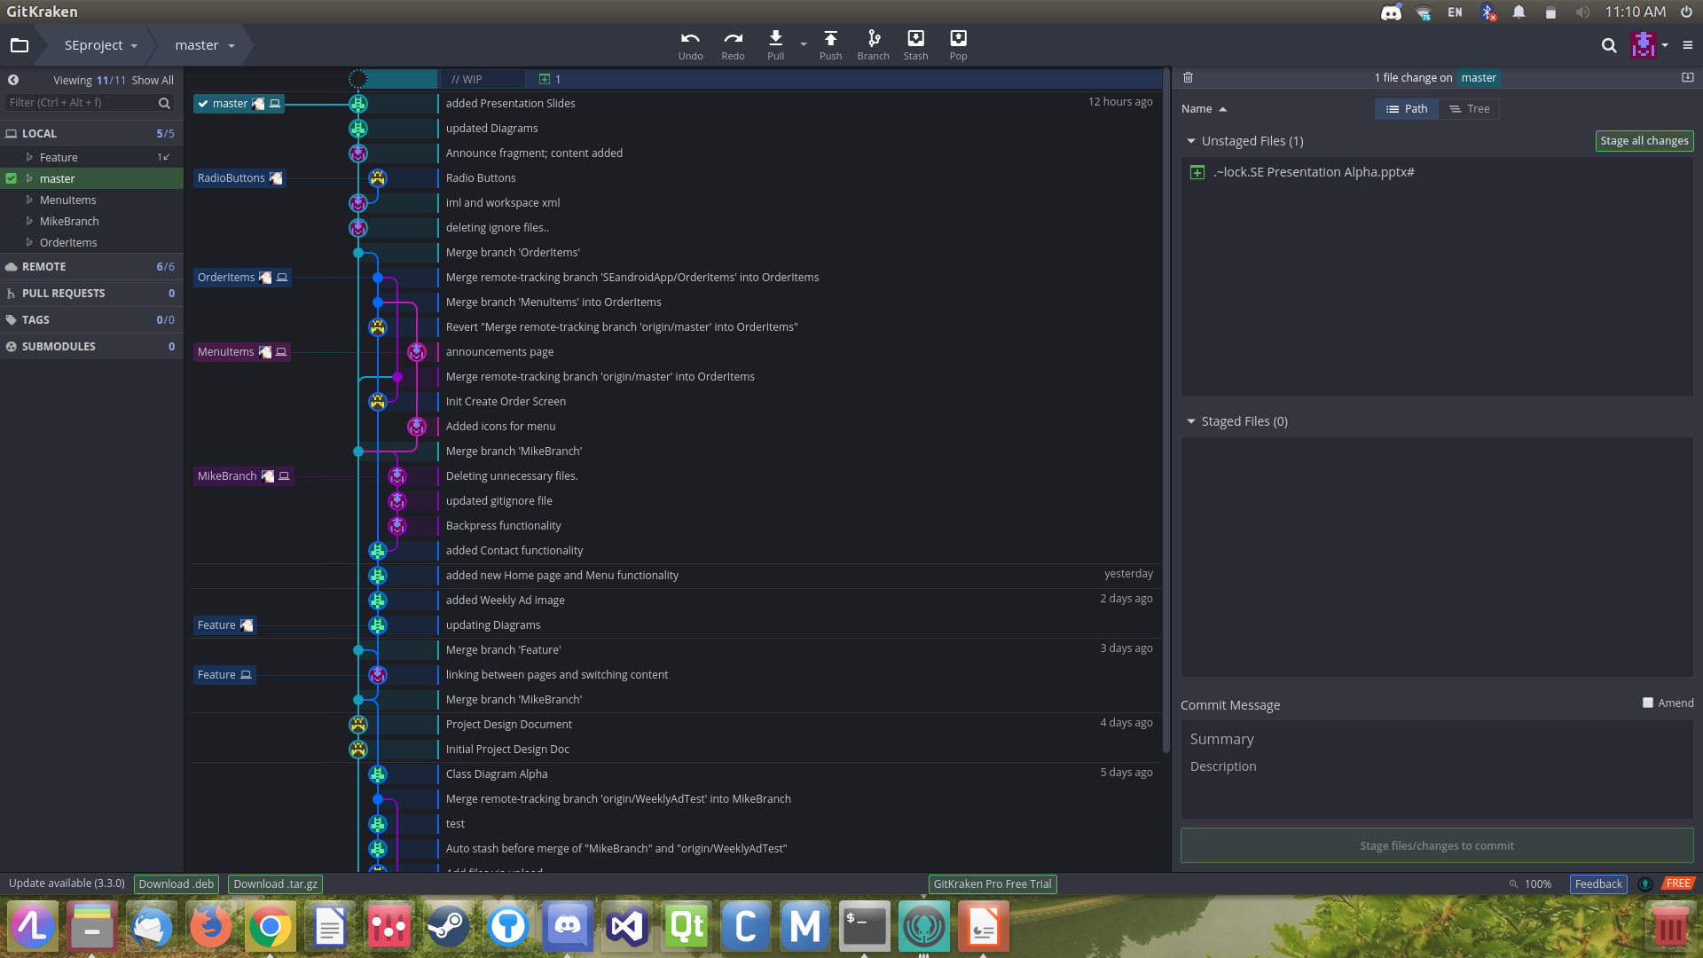
Version Control: GitHub

Slide 7
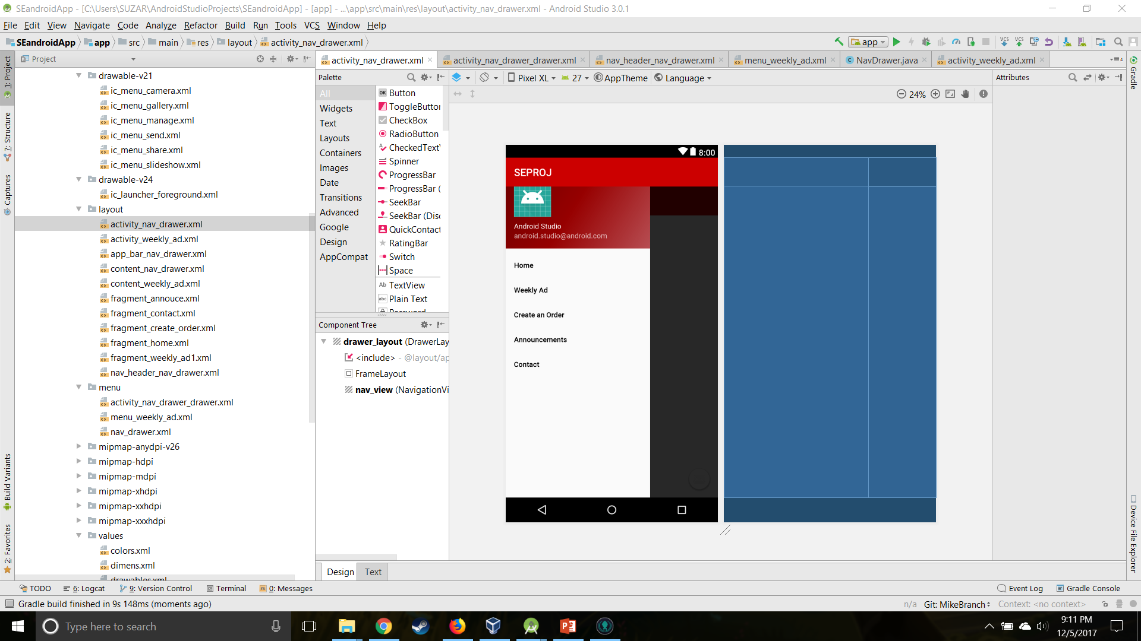
Development Tools: Android Studio

Slide 8
Test Cases
Home Page
Press NavBar to maximize
Select Weekly Ad
Select Announcements
Select Menu
Select Contact
Press NavBar to minimize
Scroll Up
Scroll Down
Zoom In/Out
Back button
Double tap functionality
Weekly Ad
Scroll Up/Down
Zoom In/Out
Double tap functionality
Announcements, Menu, Checkout, Contact

Slide 9
Grocery Store App Demo
Q & A

